Slide 1
How to fill out the Parent’s Financial Statement
Section 5 – Separated Family Information

Slide 2
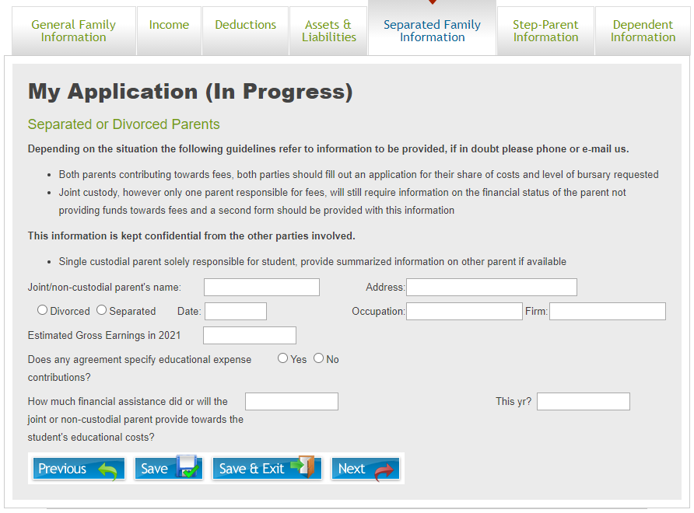
Separated Family Information
  NOTE: This page of the application will only appear if “Applicant’s parents separated/divorced”, “Single Parent” or “Applicant’s father/mother remarried/living common law” are selected in Section 6 on the “General Family Information” page. If this does not apply to you, please skip this section and move to the “Dependent Information” section.
  The “Separated Family Information” tab is used to collect information on the other parent in separated family situations.

Slide 3
Separated Family Information - 1
  Enter the other parent’s information to the extent known:
    Name
    Address
    Select if you are Divorced or Separated and on which date that occurred
    Their occupation and the firm that they work for
  Provide an estimate of their upcoming earnings if you are able
  Select if an agreement exists that specifies educational expense contributions
  Enter the amount if any of financial assistance that the other parent provided or plans to provide towards the student’s educational costs.
    NOTE: This amount is in addition to any child support that may have been noted earlier in Section 10 - E

Slide 4
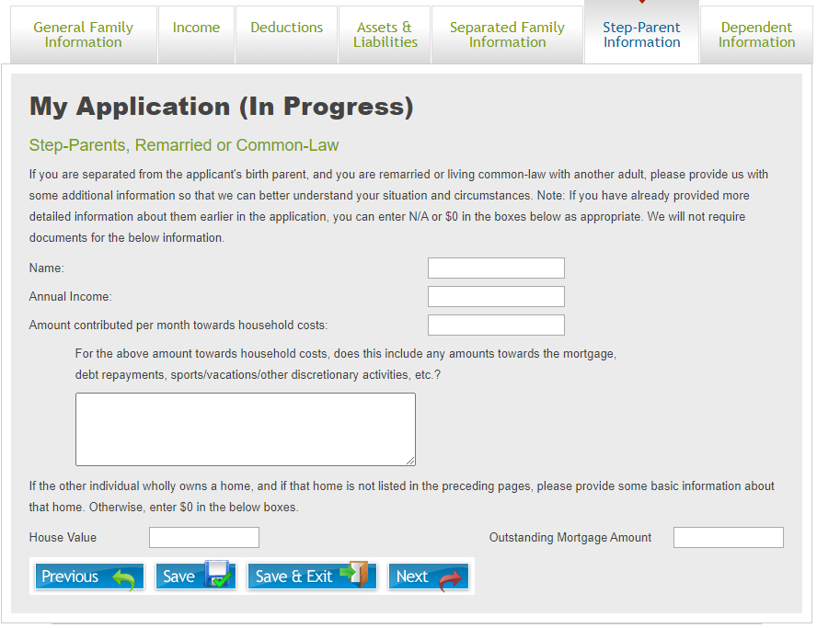
Step-Parent Information - 1
  NOTE: This page of the application will only appear if “Is the applicant’s Mother/Father remarried/living common law” is selected in Section 6a or if Stepfather/Stepmother is selected in Sections 5 and/or 7. If this does not apply to you, please skip this section and move to the “Dependent Information” section.
  The “Step-Parent Information” tab is used to collect information on any step-parents in separated family situations. If full information has been provided on the step-parent in the preceding sections, this section can be left blank.

Slide 5
Step-Parent Information
  Enter the step-parent’s information
    Name
    Annual Income
  Provide an estimate of the monthly amount that the step-parent contributes towards the household expenses. This includes but is not limited to: groceries, utilities, other daily household expenses, mortgage payments, car payments, etc.
  If the step-parent owns a home that is not listed previously in the Assets/Liabilities section, provide information on the current house value and any outstanding mortgage amounts

